Slide 1

The Sparks Foundation Task-3
Data Science and Business Analytics
Exploratory Data Analysis- Retail
Author -Muhammad Ayaan Shaikh

Slide 2
Task Explanation
Perform an Exploratory Data Analysis on Dataset ‘SampleSuperstore’.
As a business manager, try to find out the weak areas where you can work to make more profit.
What all business problems can you derive by exploring the data?
You can choose any of the tool of your choice (Python/PowerBI/Excel/SAP/SAS)
Dataset: https://bit.ly/3i4rbWI
Task Submission
Create dashboard, Screen-record along with your audio explaining the charts and interpretations.
Upload the recording either on YouTube or LinkedIn.

Slide 3
Tools Used
IBM Cognos Analytics

Slide 4
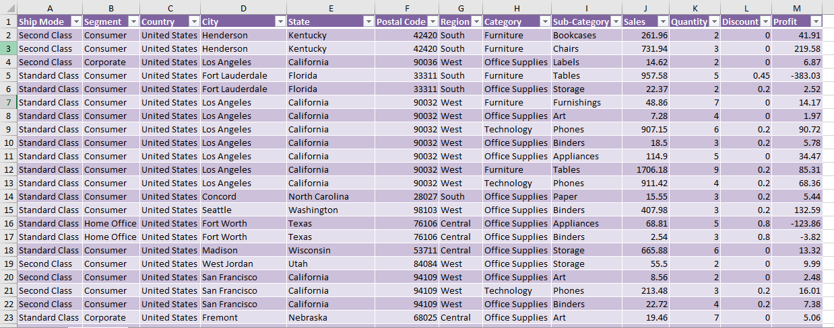
Data Set

Slide 5
Final Conclusion
By our analysis we understand that: 1) Phones sub-category has the highest sales
2) Tables sub-category have the highest loss of -17,725$ followed by Bookmarks.
3) The profit difference between chairs and phones is to high as compared to the sales margin.
4) Fasteners have the least sales.

Slide 6



Links
YouTube Video – https://www.youtube.com/channel/UCODZYmhwBKaBaCZn0cO_7BA
Git Hub – https://github.com/Ayaanshaikh20
LinkedIn – https://www.linkedin.com/in/muhammad-ayaan-shaikh-178aa5220/
IBM Cognos - https://us1.ca.analytics.ibm.com/bi/?perspective=dashboard&pathRef=.my_folders%2FSparks%2Bibm&action=view&mode=dashboard&subView=model00000183a7285284_00000000
GOOD NEWS!!!
Sparks Foundation has launched a new website which provides various internship opportunities for technical as well as non-technical students. For more information please visit the link https://internship.thesparksfoundation.info/

